Slide 1
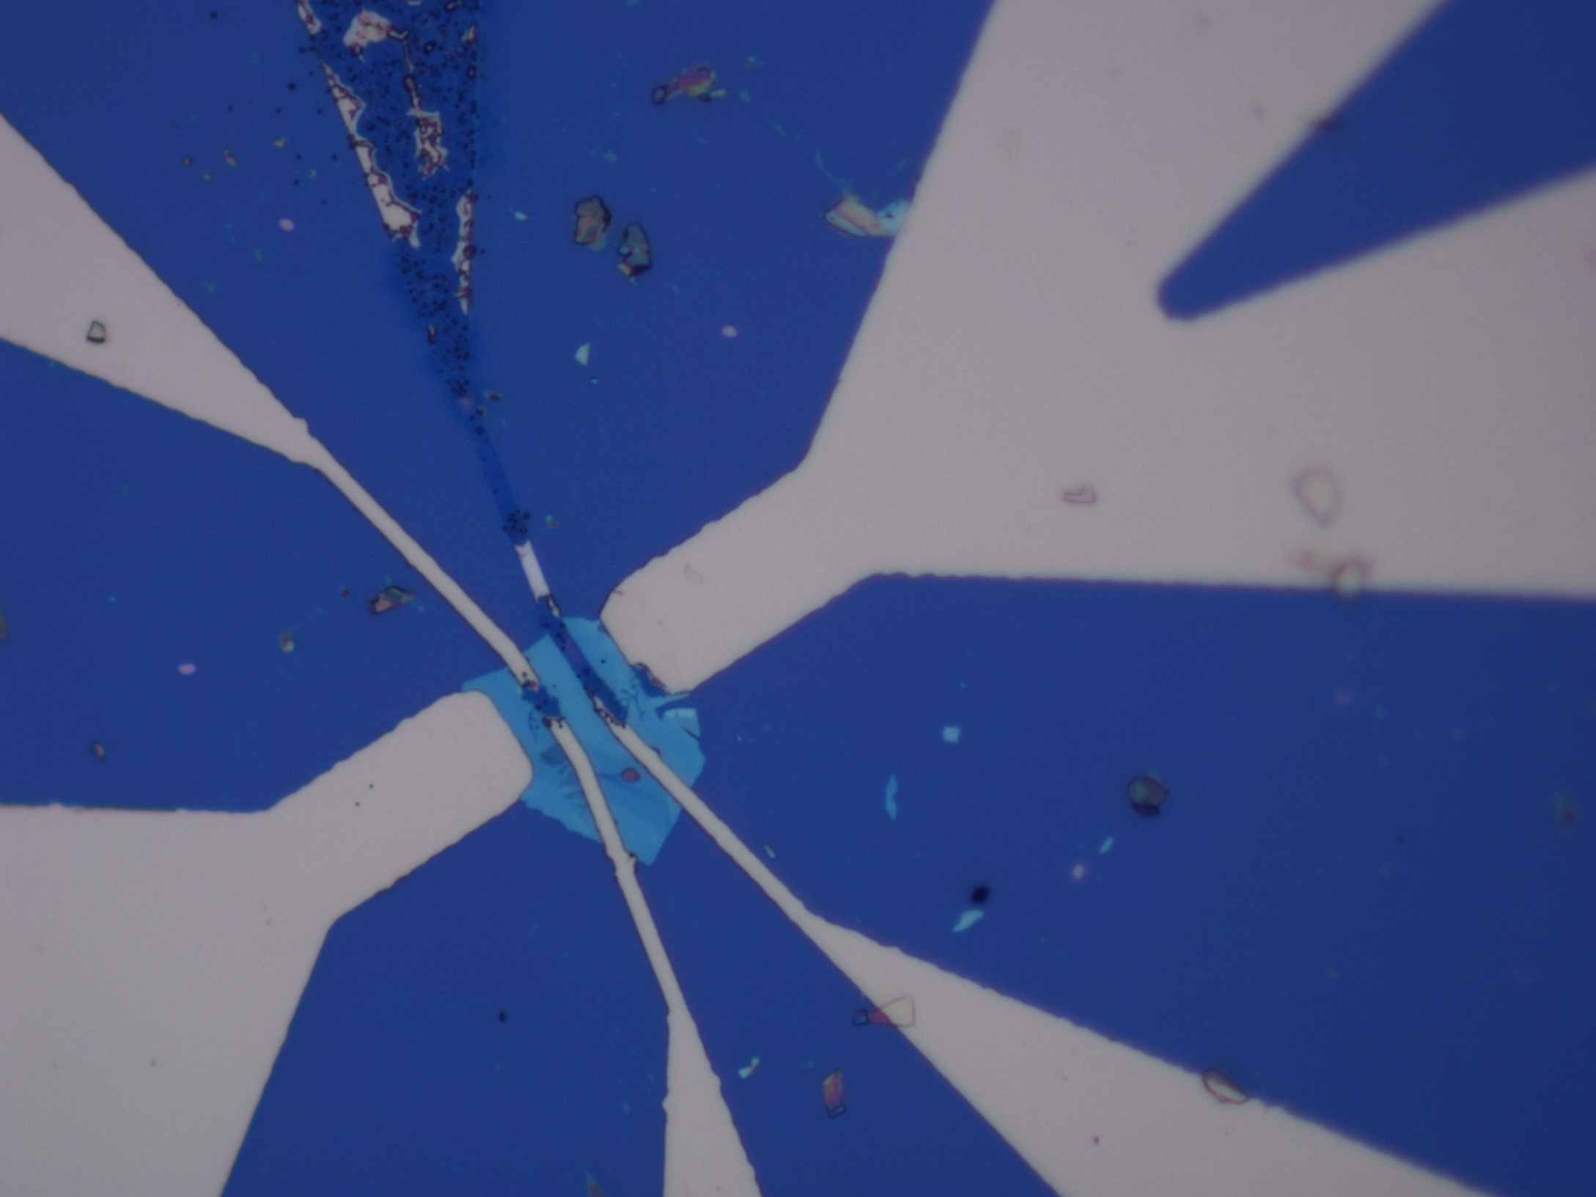
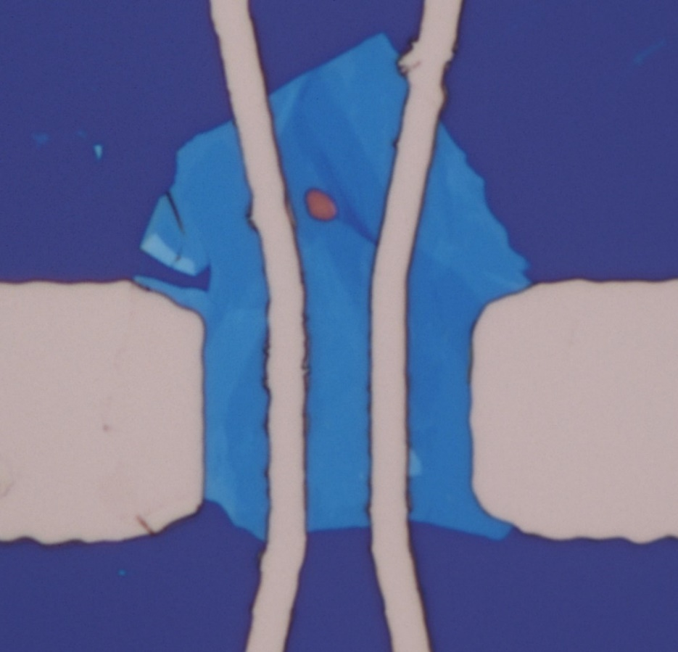
10μm

Slide 2
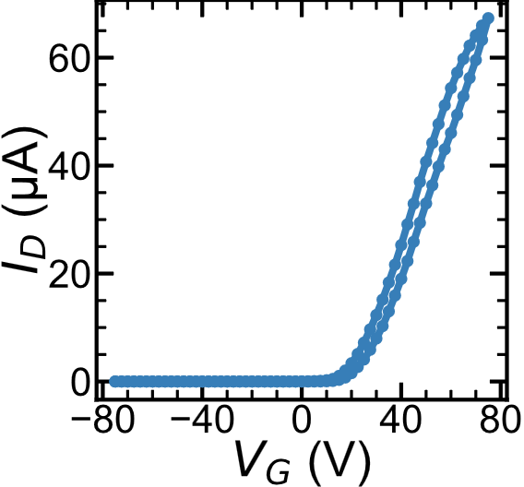
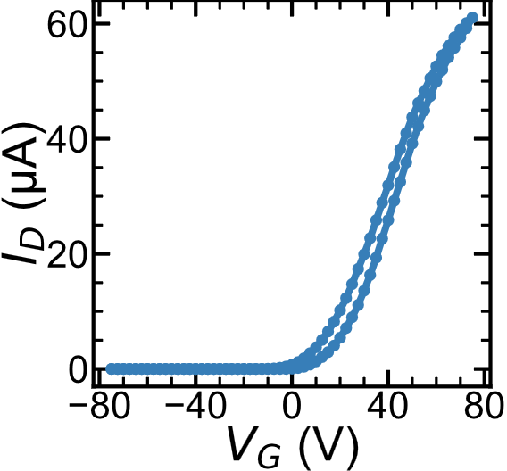
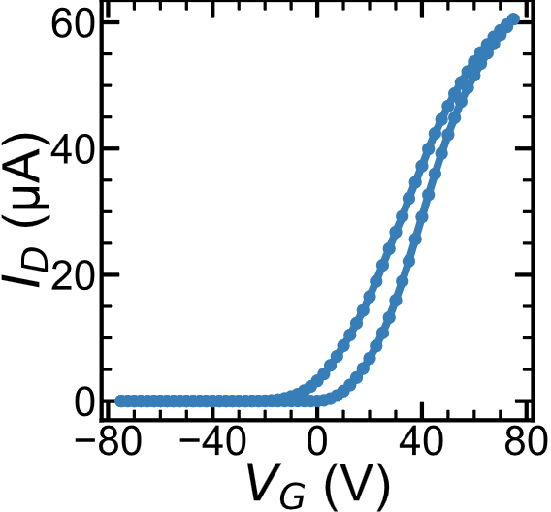
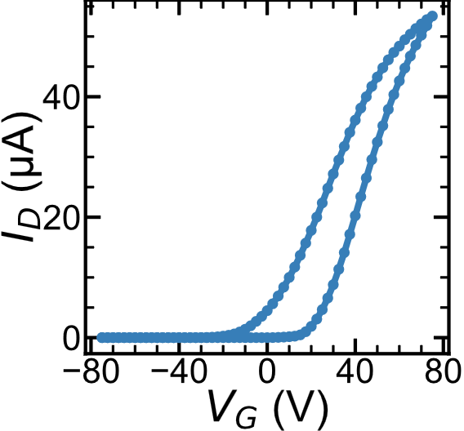
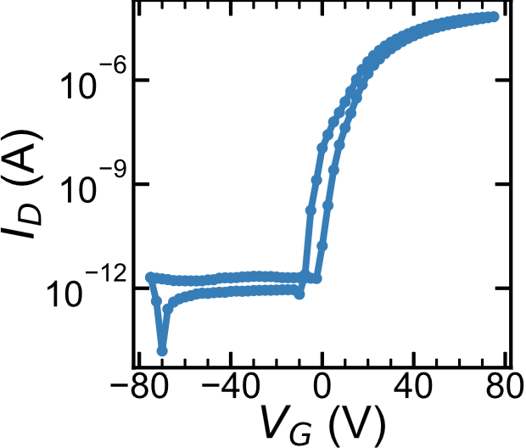
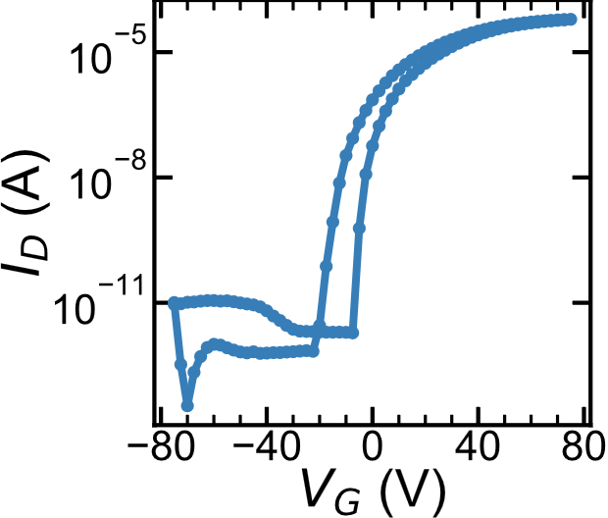
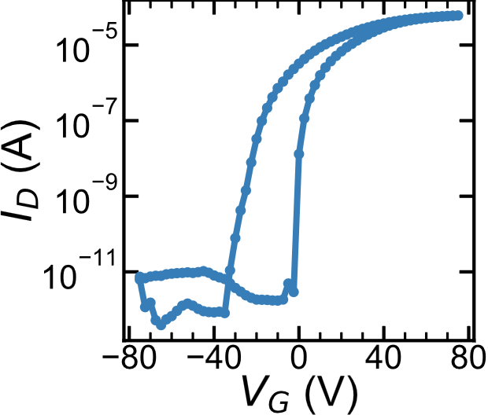
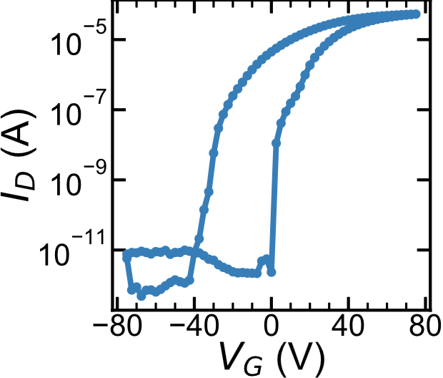
3K
50K
100K
150K
V_{SD} = .1V

Slide 3
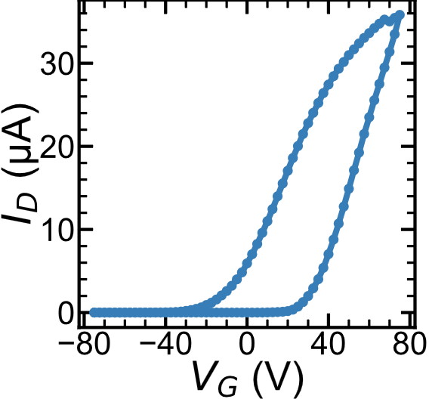
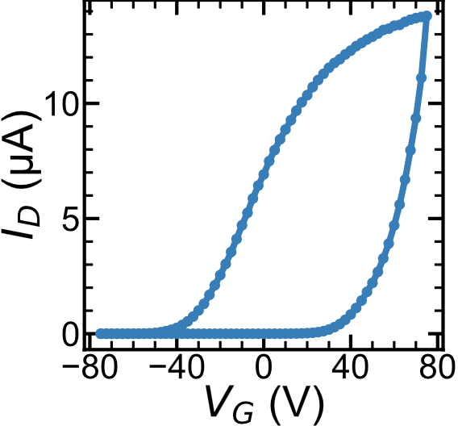
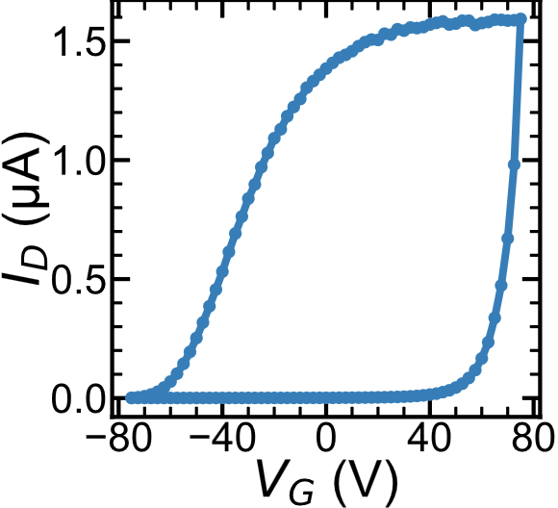
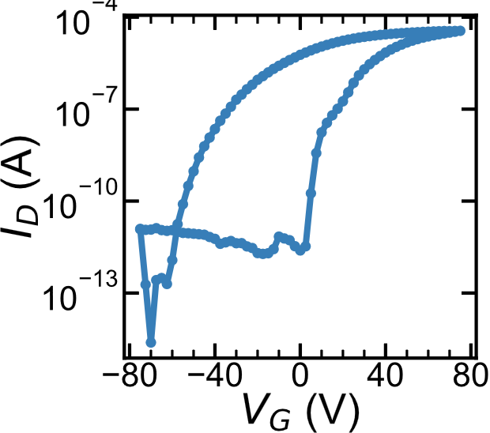
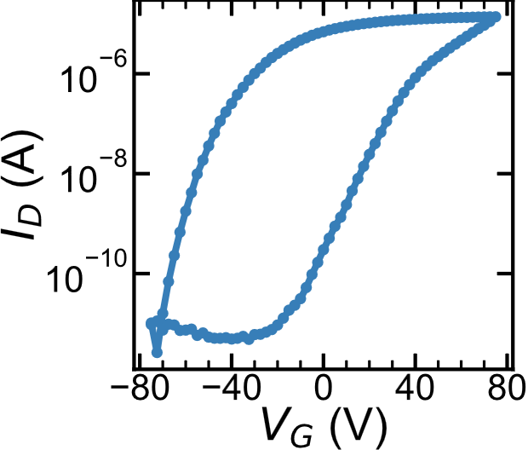
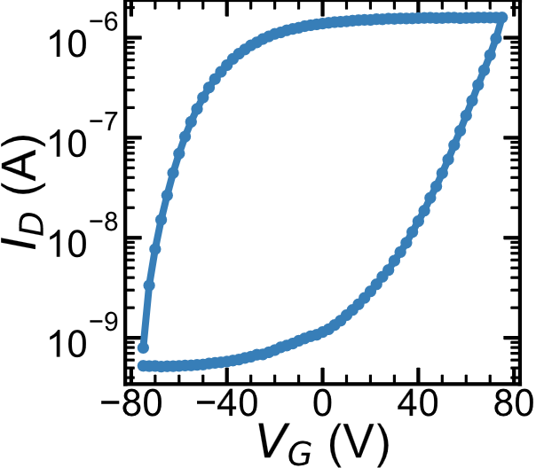
200K
250K
300K

Slide 4
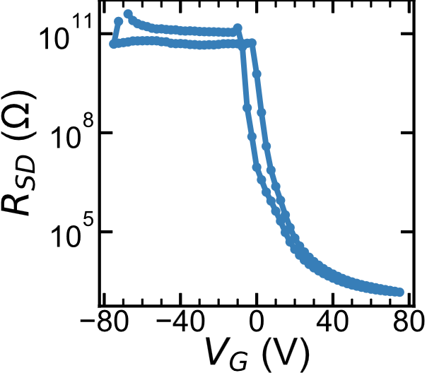
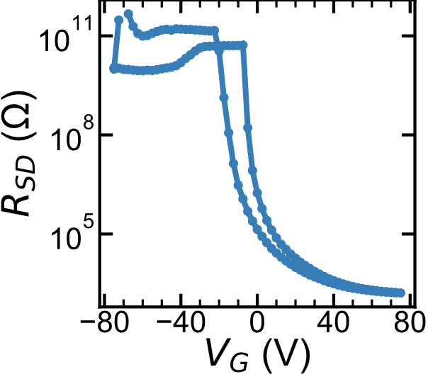
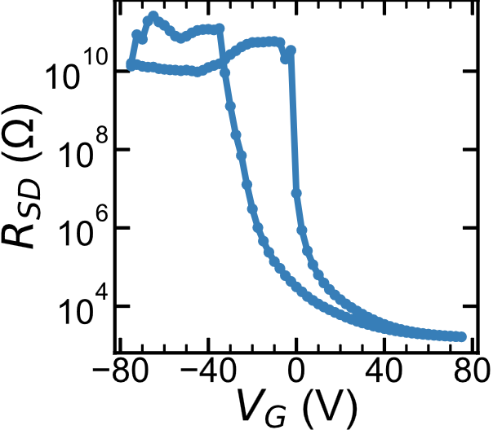
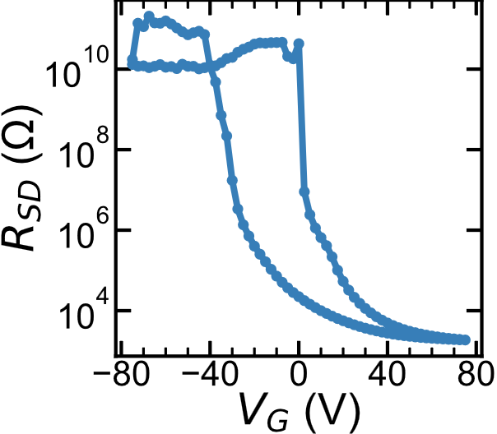
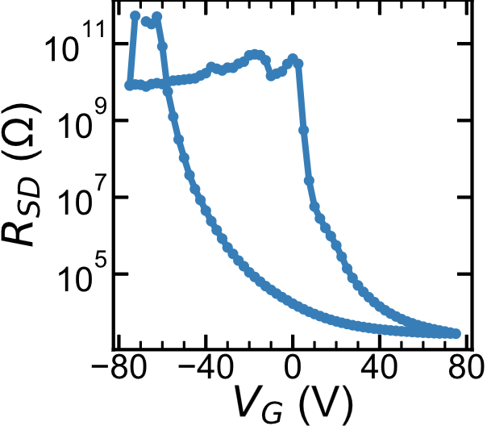
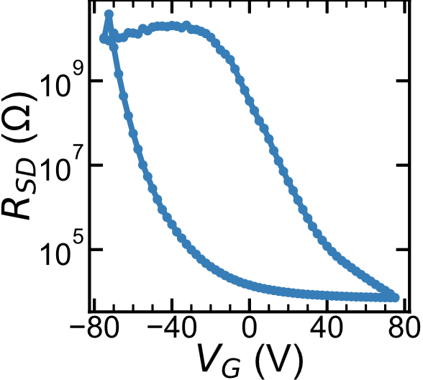
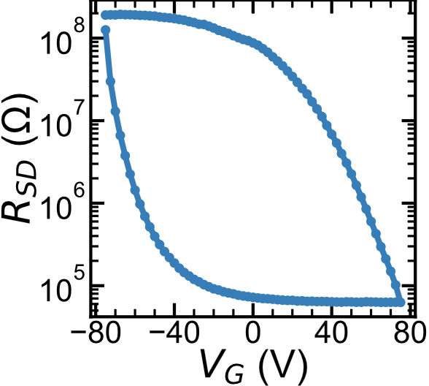
3K
150K
50K
100K
300K
200K
250K

Slide 5
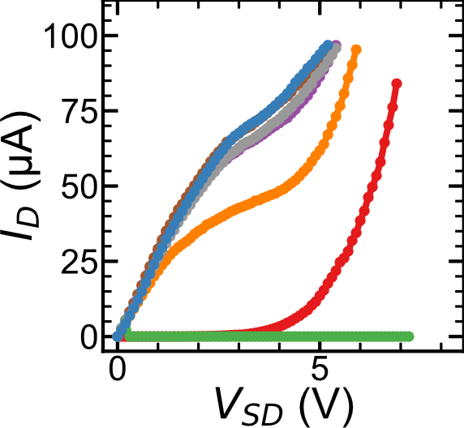
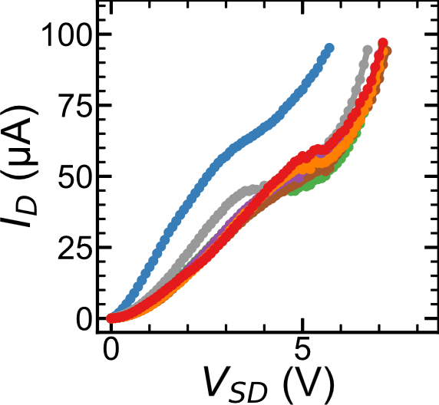
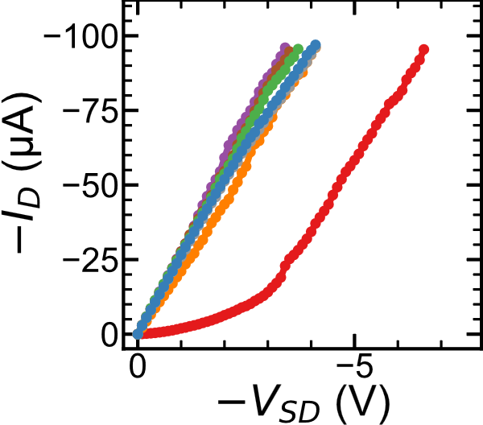
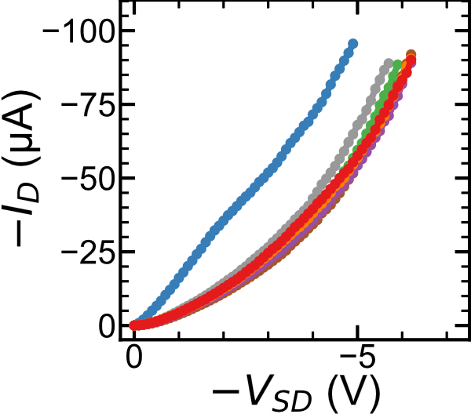
TODO: add labels
Increasing V_{G}
Decreasing V_{G}
Increasing V_{G}
Decreasing V_{G}

Slide 6
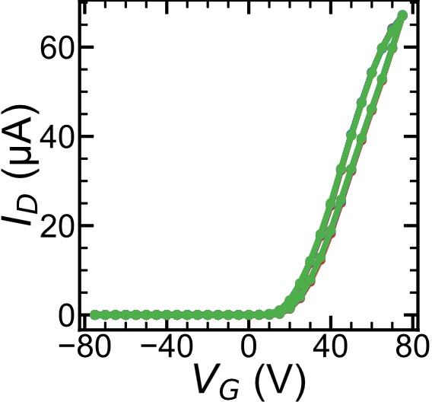
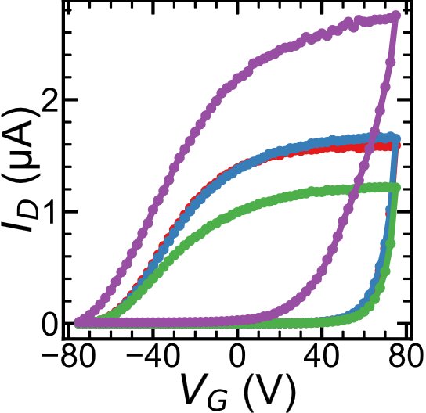
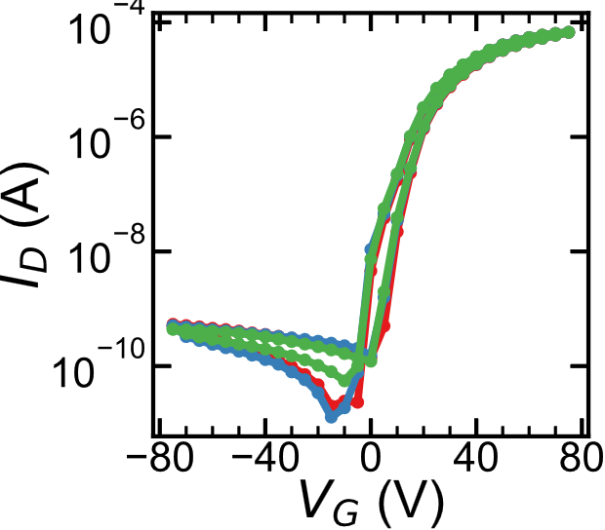
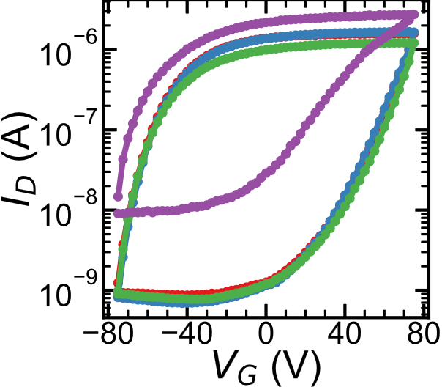
3K rates
009 1V/s
010 2V/s
011 .1V/s
300K Rates
018 2V/s
019 1V/s
020 .1V/s
051 2V/s

Slide 7
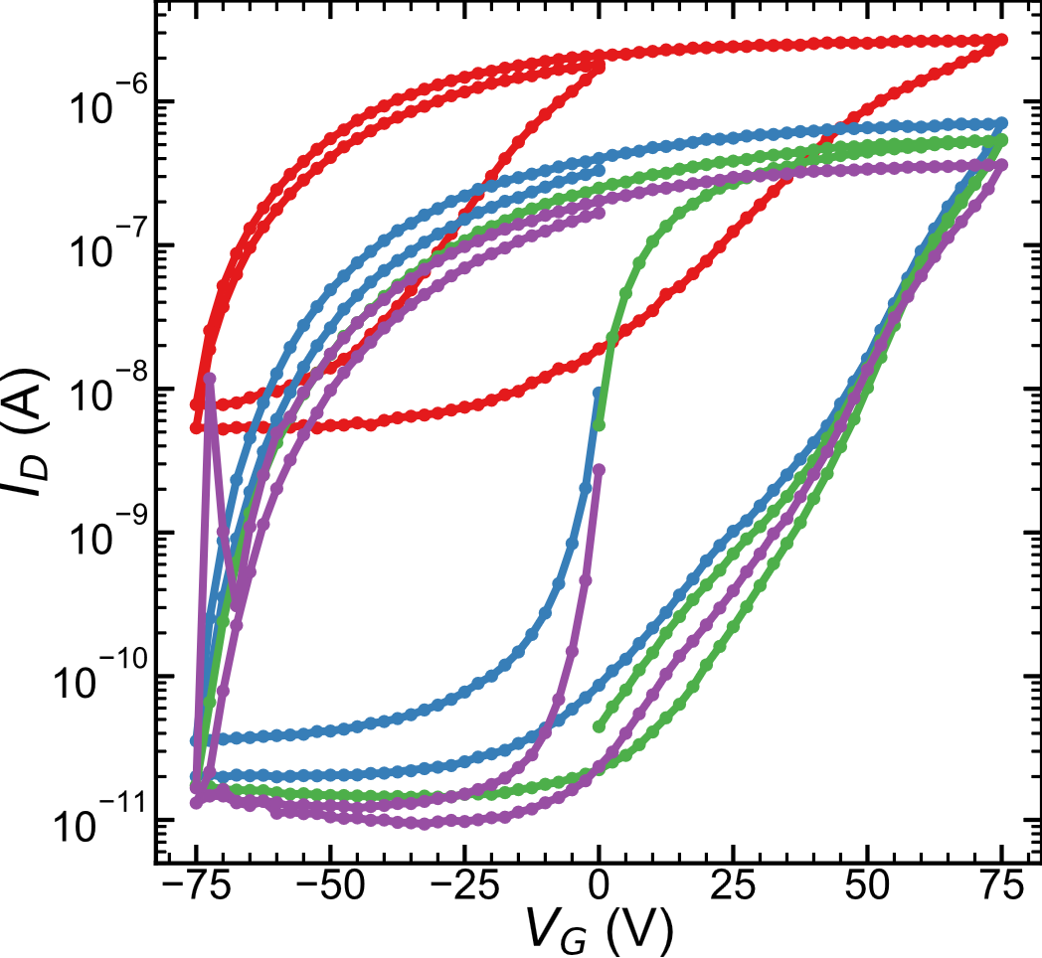
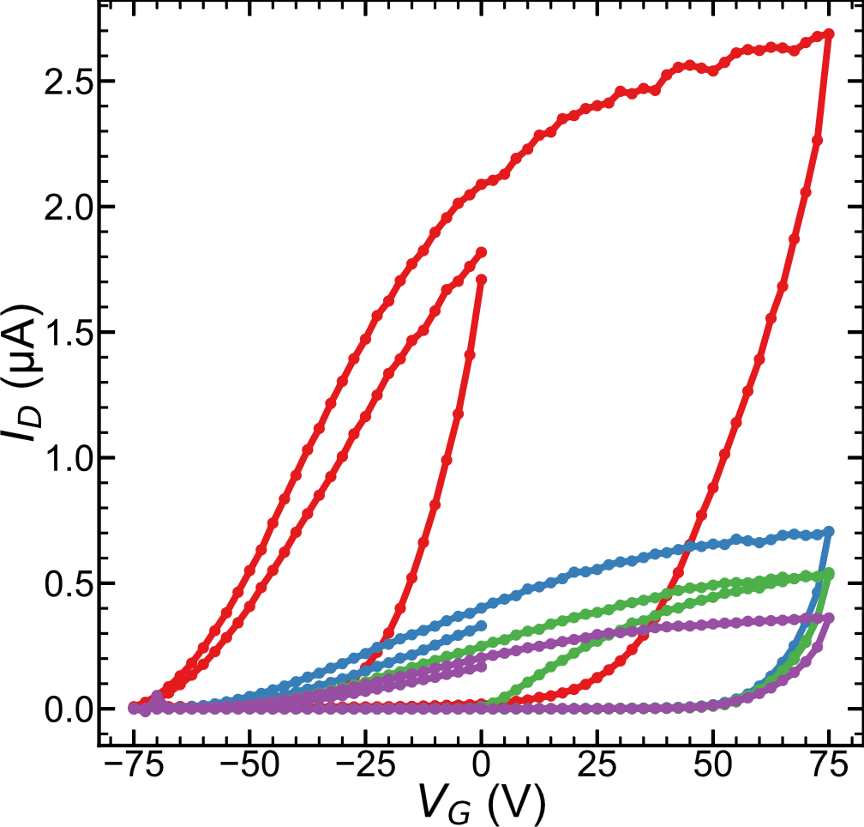
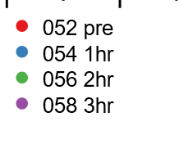
Heating to 400K
056 Reverse direction

Slide 8
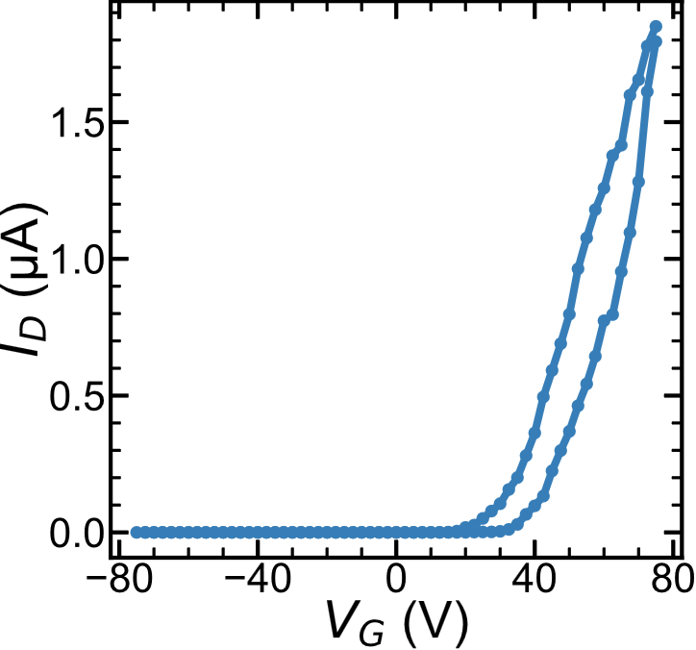
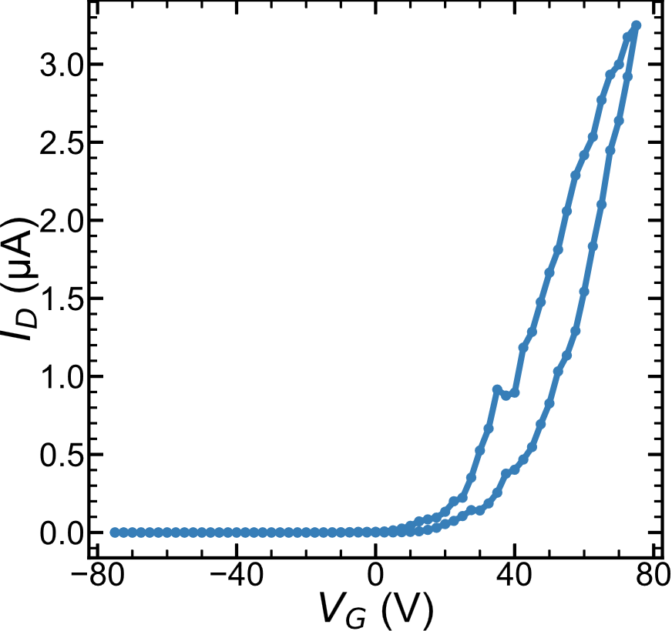
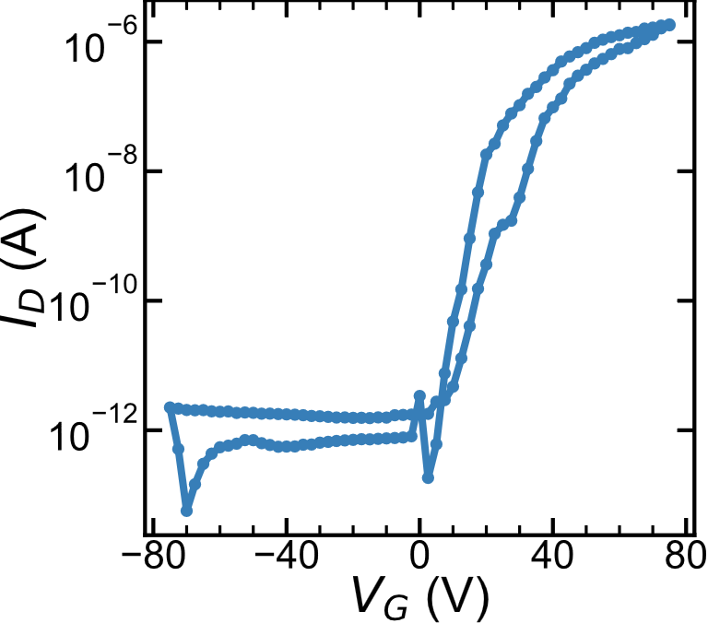
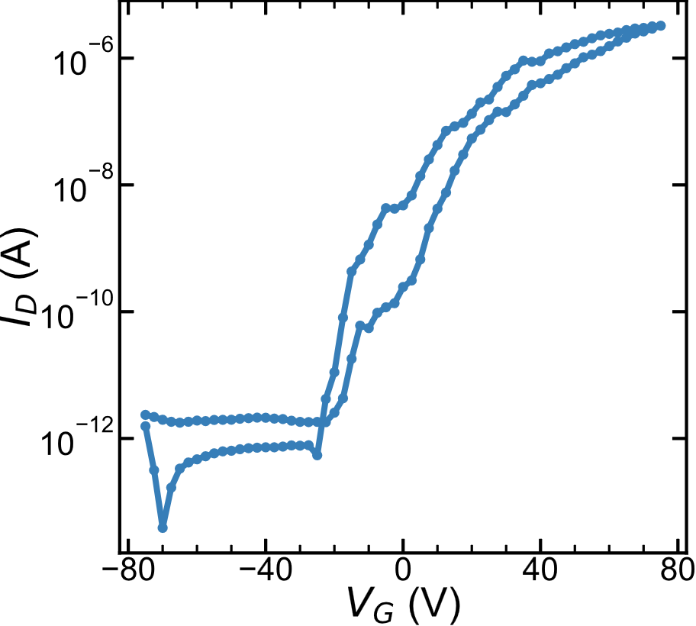
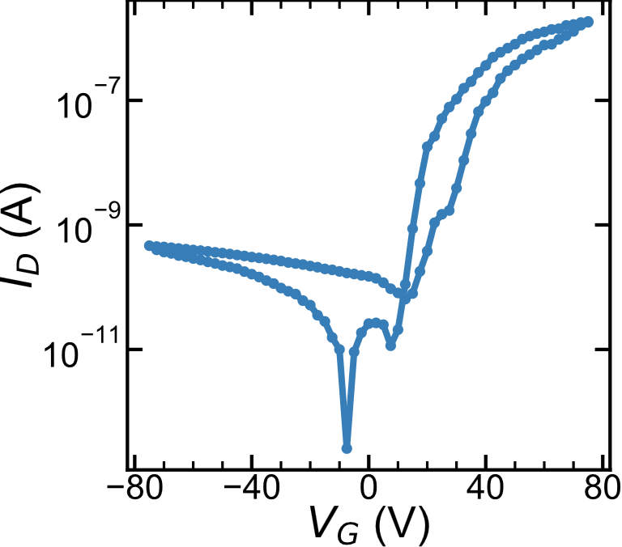
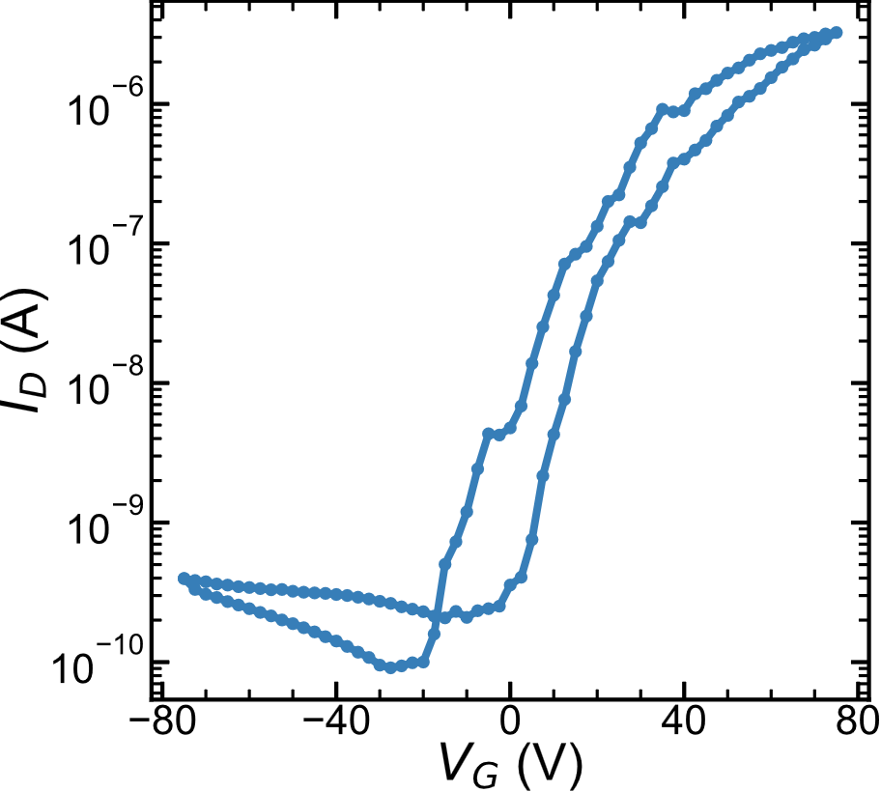
3K
before
3K
After
heating
3K
After
IV

Slide 9
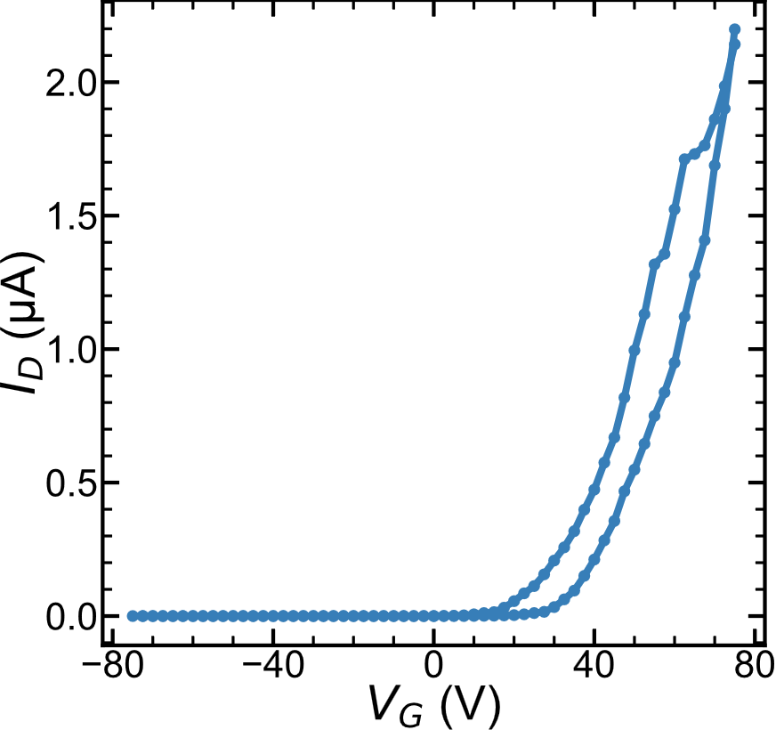
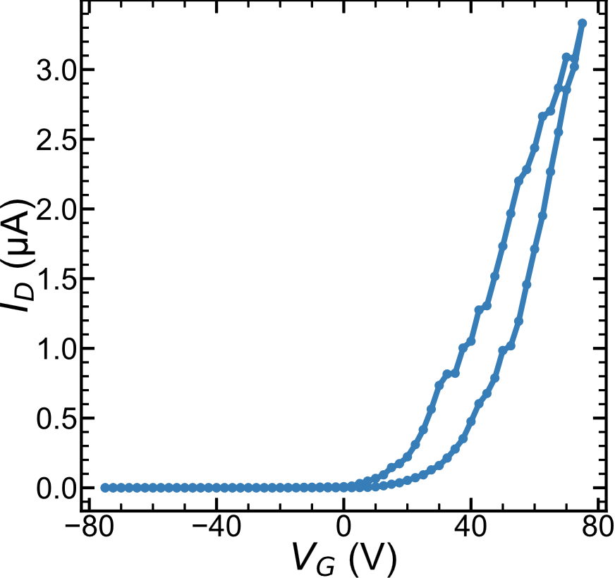
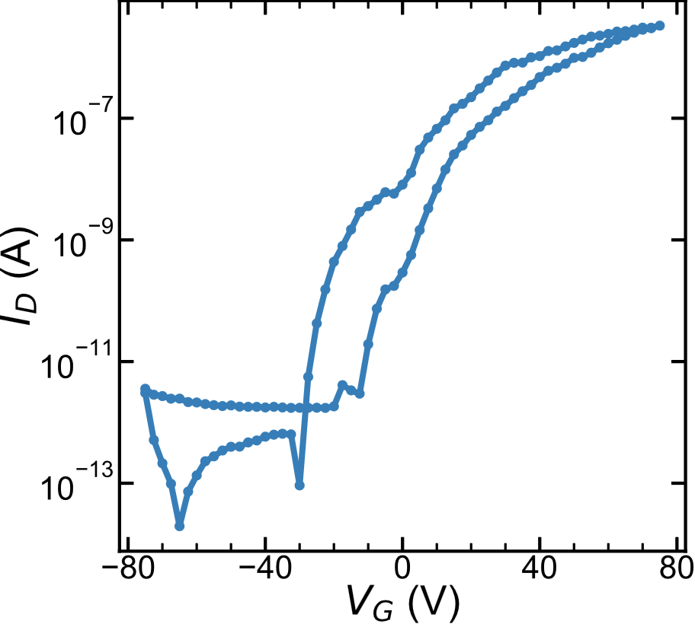
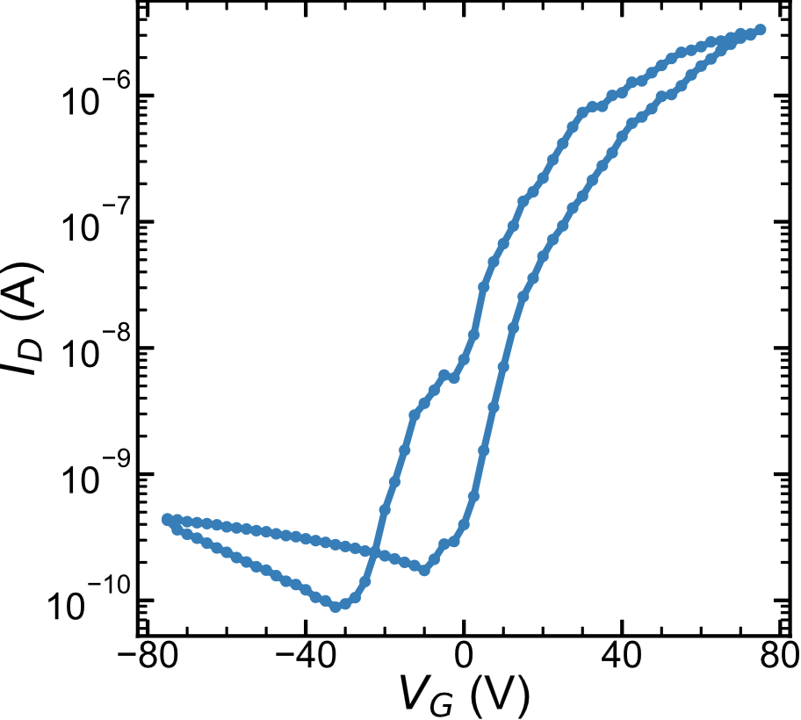
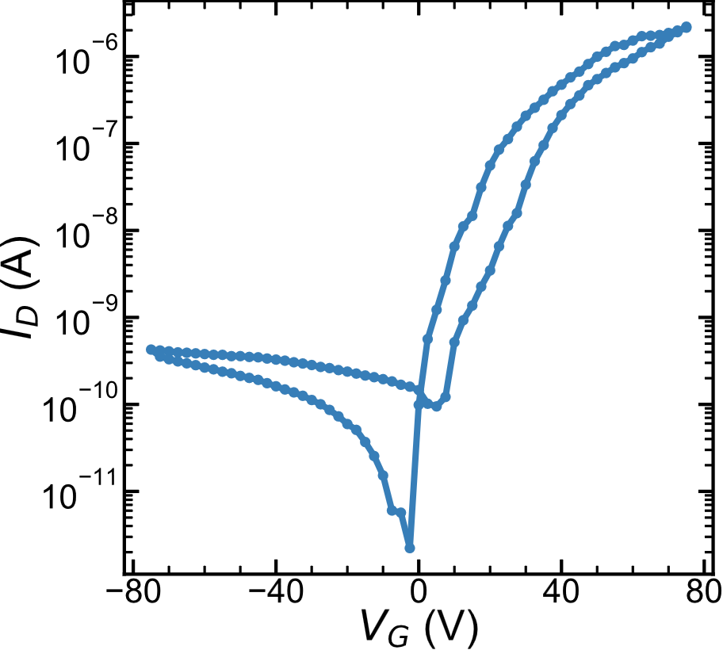
50K
Before
50K
After heating
50K
After IV

Slide 10
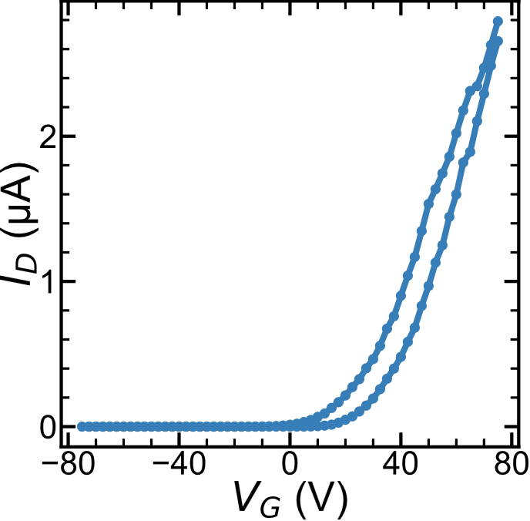
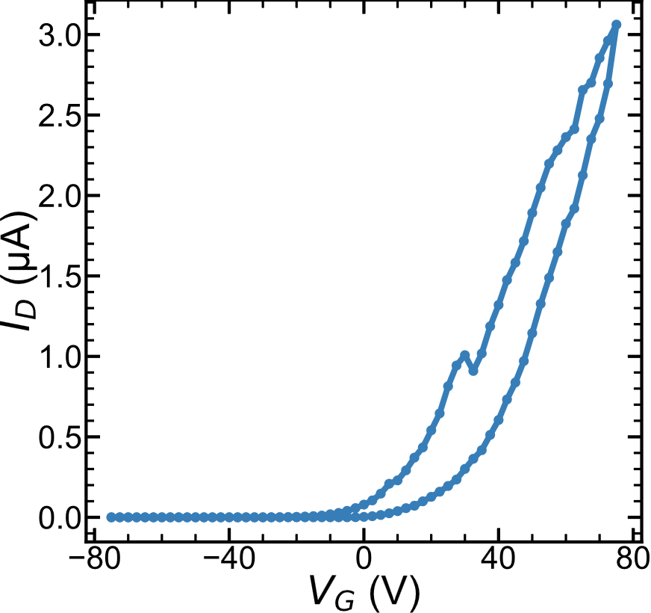
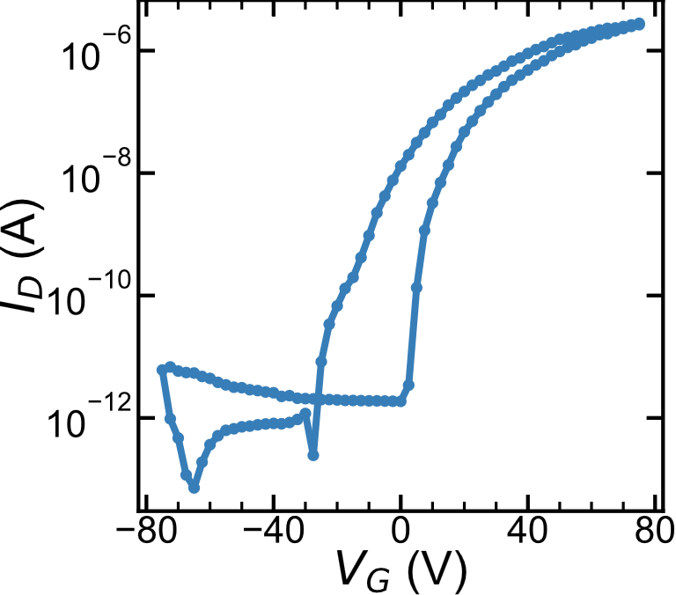
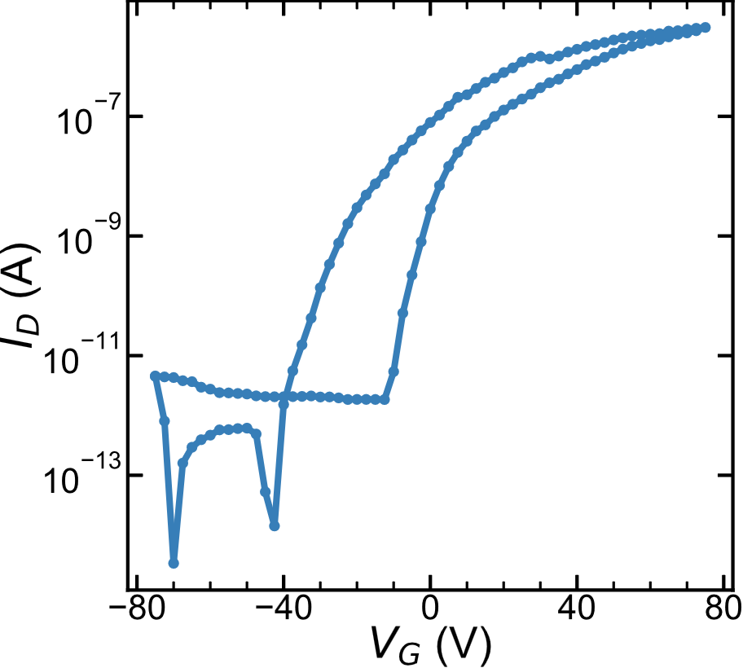
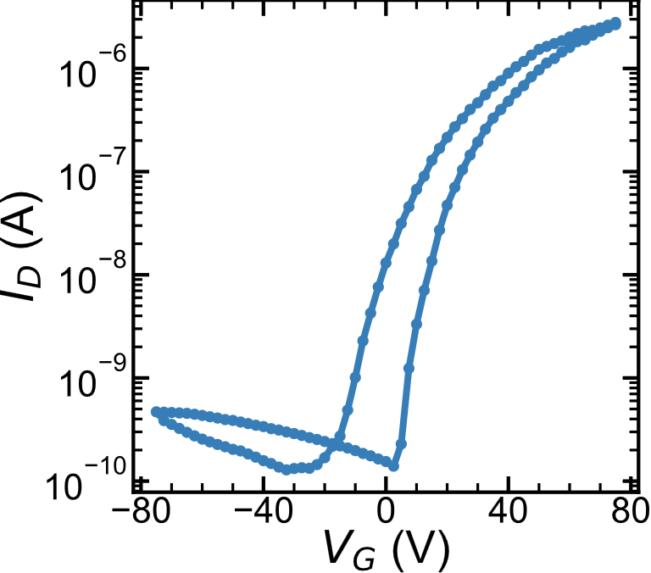

150K
after
150K
After
IV
150K
before

Slide 11








300K
After
Heating
(idle 12hrs)
300K
After
IV
300K
before

Slide 12












3K
After heating
50K
100K
150K
200K

Slide 13



250K
After
heating
300K

Slide 14




Increasing V_{G}
Decreasing V_{G}
After heating, waiting a few days, (no LHe) and life?
Increasing V_{G}
Decreasing V_{G}

Slide 15






3K
After IV
50K
100K
150K
200K

Slide 16



250K
After
IV
300K

Slide 17




Increasing V_{G}
Decreasing V_{G}
3K
Increasing V_{G}
Decreasing V_{G}

Slide 18








pre
Post heating
Post IV
100V loop
75V
75V
50V
50V
25V
25V
0V
0V

Slide 19




REDO
Increasing V_{G}
300K Redo
Decreasing V_{G}
Increasing V_{G}
Decreasing V_{G}

Slide 20



300K, rate
Log
Log (-I_{leak})
2V/s
.5V/s
.1V/s

Slide 21















3K
10K
20K
30K
40K
Log
Log (-I_{leak})

Slide 22















50K
60K
70K
80K
90K
Log
Log (-I_{leak})

Slide 23









100K
150K
200K
Log
Log (-I_{leak})

Slide 24













3K
10K
20K
30K
40K
50K
60K
70K
80K
90K
100K
150K
200K

Slide 25


Backgate forms a weird leak current, very persistent.
This might be due to the start of a breakdown a while ago. Didn’t go full avalanche so it still works?

Slide 26

Raw
Fit

Slide 27




New wires – in air for ~20min

Slide 28


MR
MR “symmetrized”

Slide 29


